Slide 1

Chapter 3.1
Stochastic Processes
Performance Evaluation of the Internet of Things (IoT)
Module Course: Performance Evaluation of Distributed Systems
Prof. Tobias Hoßfeld, Summer Semester 2022

Slide 2
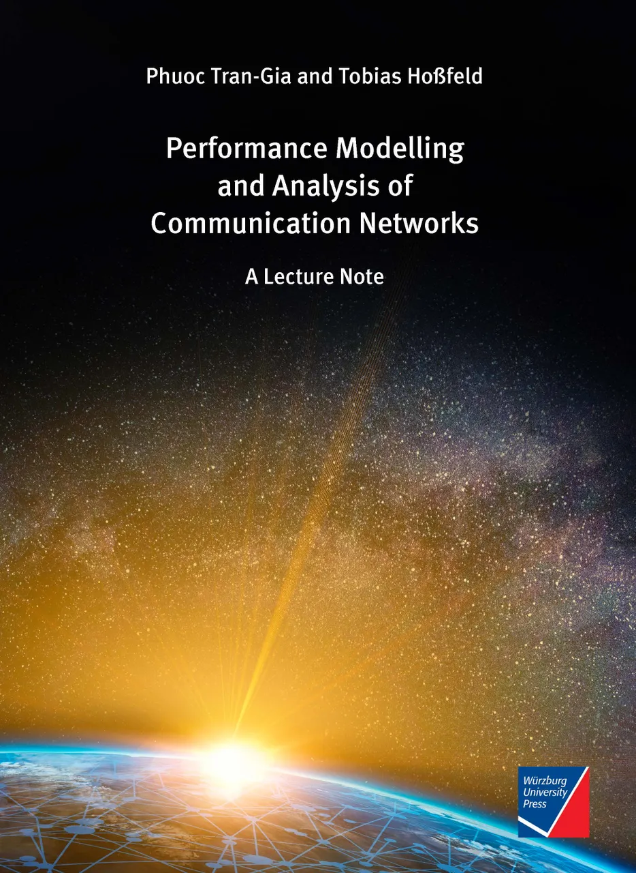
Disclaimer and Copyright Notice
Lecture slides, figures, and scripts are based on the open access text book “Performance Modeling and Analysis of Communication Networks”. The book and scripts are licensed under the Creative Commons License Attribution-ShareAlike 4.0 International (CC BY-SA 4.0). If you remix, transform, or build upon the material, you must distribute your contributions under the same license as the original.
The book must be cited and the disclaimer attached when using lectures slides or scripts.
Tran-Gia, P. & Hossfeld, T. (2021). Performance Modeling and Analysis of Communication Networks - A Lecture Note. Würzburg University Press. https://doi.org/10.25972/WUP-978-3-95826-153-2
Website to download book, exercises, slides and scripts: https://modeling.systems/

Slide 3
Chapter 3
3 Elementary Random Processes
3.1 Stochastic Processes
3.1.1 Definition
3.1.2 Markov Processes
3.1.3 Elementary Processes in Performance Models
3.2 Renewal Processes
3.2.1 Definition
3.2.2 Analysis of Recurrence Time
3.3 Poisson Process
3.3.1 Definition of a Poisson Process
3.3.2 Properties of the Poisson Process
3.3.3 Poisson Arrivals during Arbitrarily Distributed Interval
3.4 Superposition of Independent Renewal Processes
3.4.1 Superposition of Poisson Processes
3.4.2 Palm-Khintchine Theorem
3.5 Markov State Process
3.5.1 Definition of Continuous-Time Markov Chain
3.5.2 Transition Behavior of Markovian State Processes
3.5.3 State Equations and State Probabilities
3.5.4 Examples of Transition Probability Densities
3.5.5 Birth-and-Death Processes

Slide 4
Stochastic Processes
Examples and definition

Slide 5
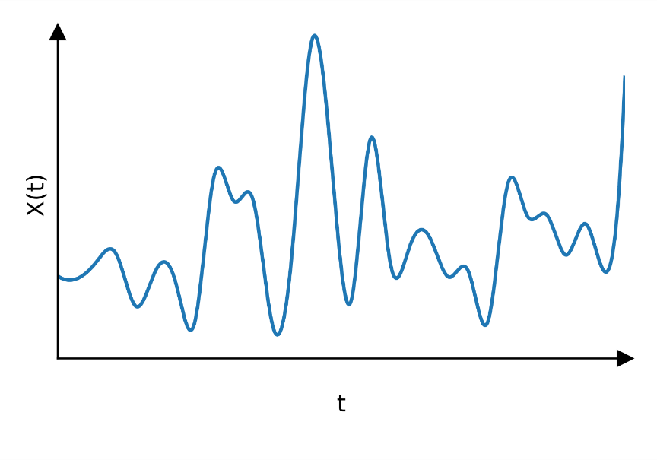
Examples
random intervals
server
active
X(t)
idle
time t
X(t)
buffer state of a router
time t
remaining workload at a server
X(t)
time t

Slide 6
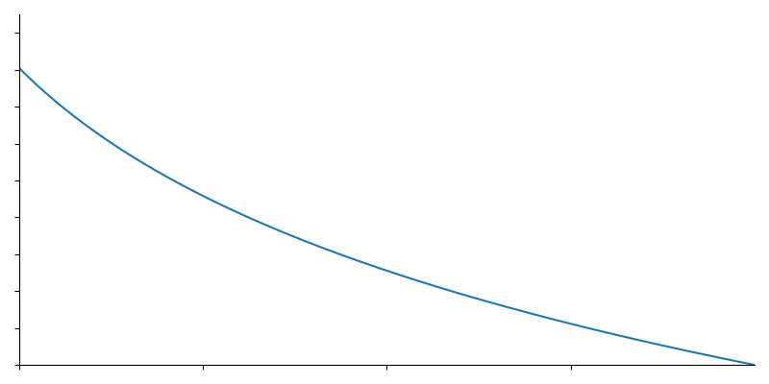
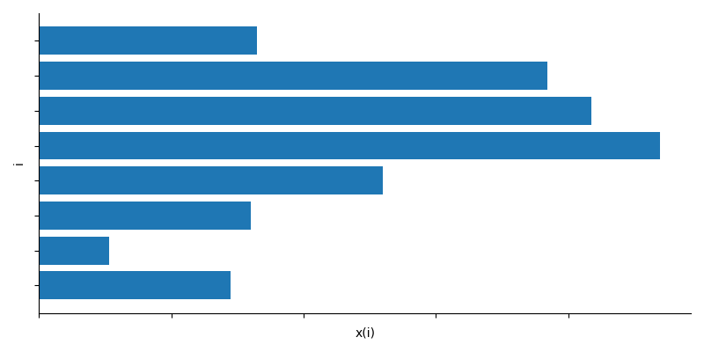
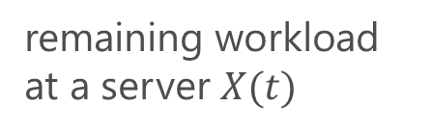
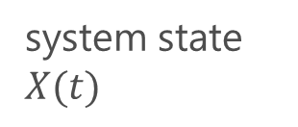
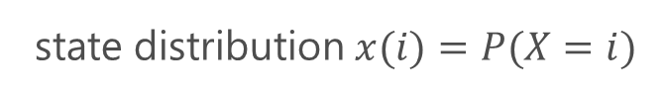
Objective of Stochastic Modeling
remaining workload at a server $X(t)$
probability density function
density
system state $X(t)$
state distribution $x(i)=P(X=i)$

Slide 7
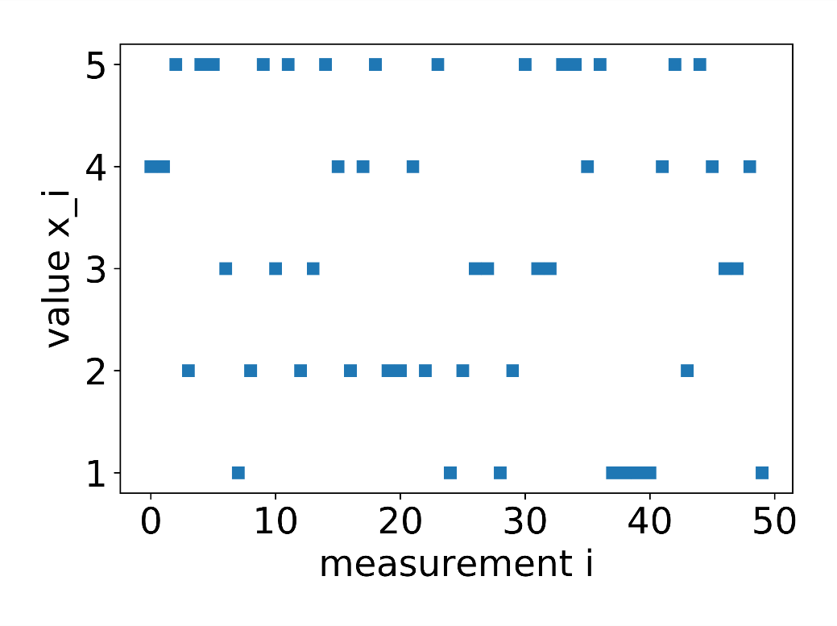
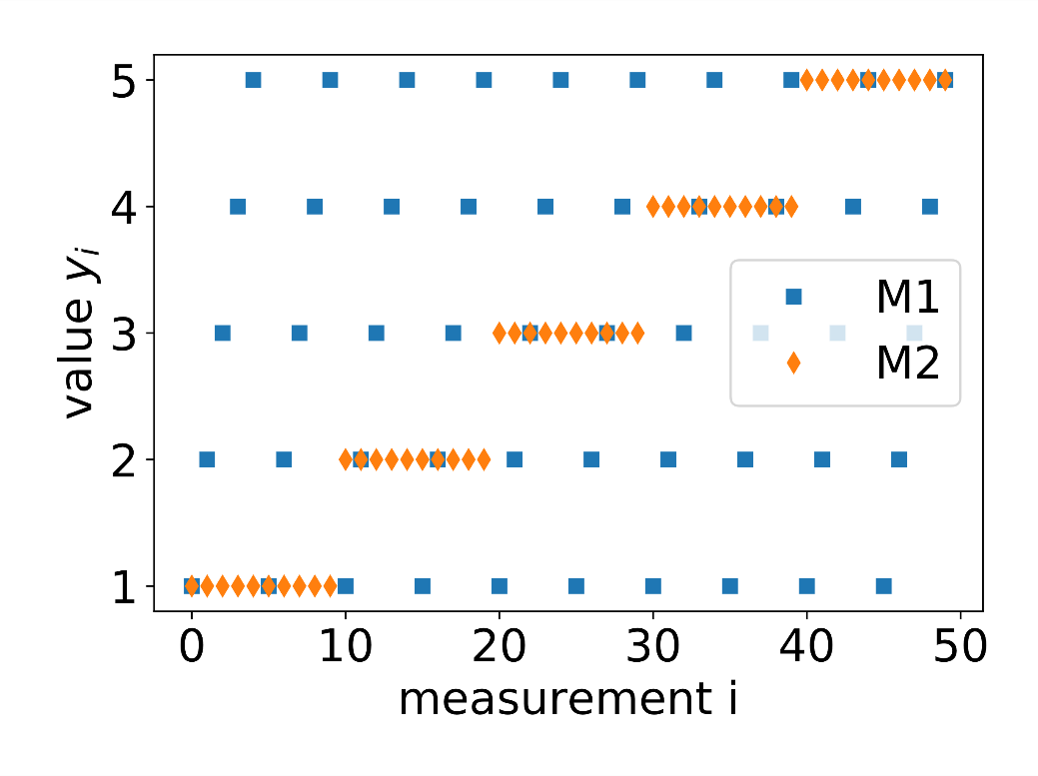
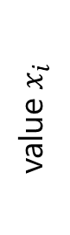
Stochastic Modeling
Same mean values, but different patterns
discrete uniform distribution X~DU(1,5)
deterministic pattern
value $x_{i}$

Slide 8
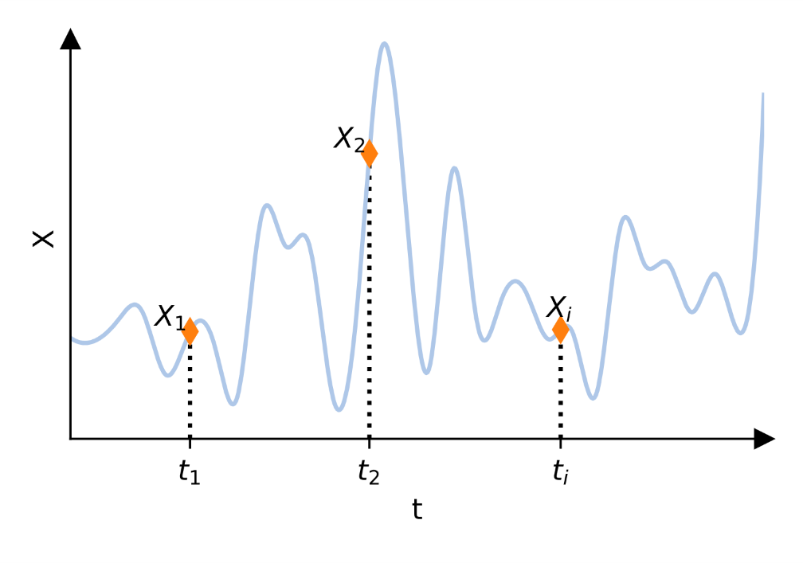

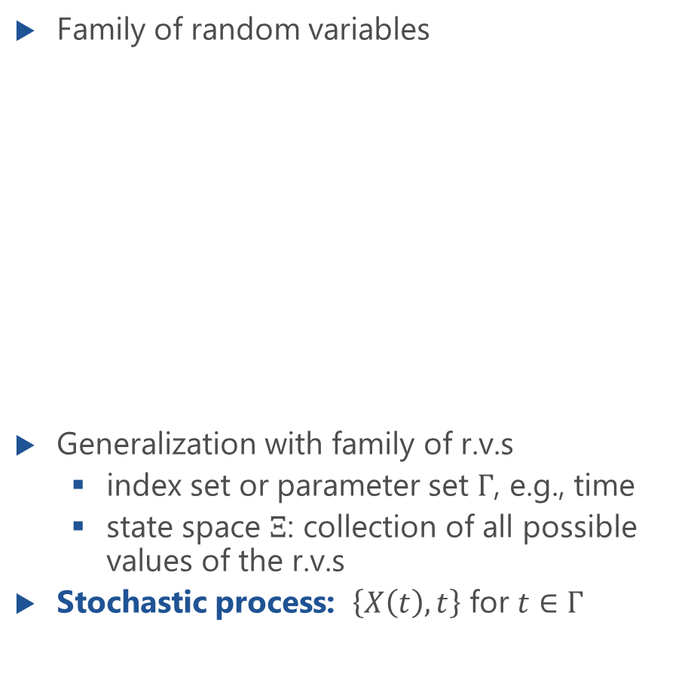
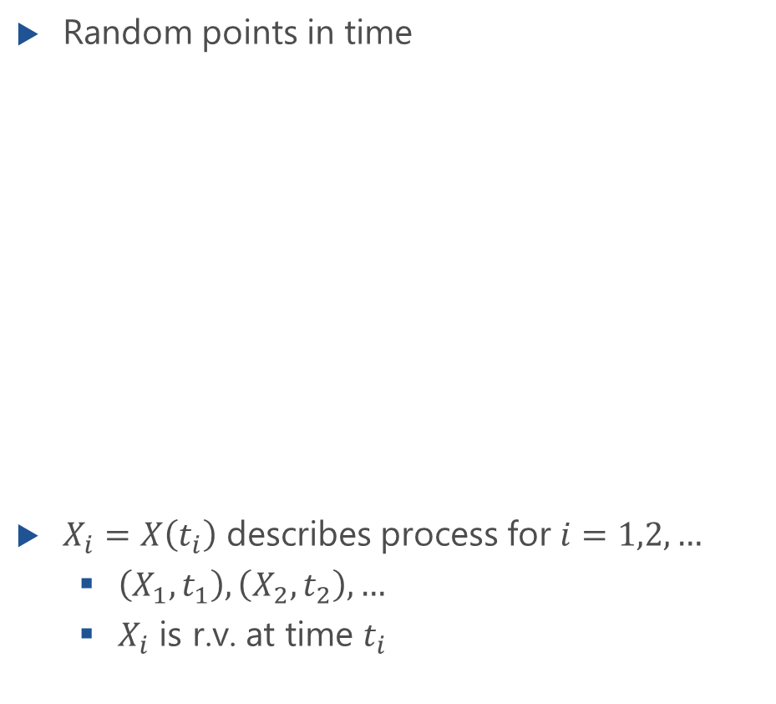
Definition
Random points in time
$X_{i}=X\left(t_{i}\right)$ describes process for $i=1,2,…$
$\left(X_{1},t_{1}\right), \left(X_{2},t_{2}\right), …$
$X_{i}$ is r.v. at time $t_{i}$
Family of random variables
Generalization with family of r.v.s
index set or parameter set $Γ$, e.g., time
state space $Ξ$: collection of all possible values of the r.v.s
Stochastic process: $\left\{X\left(t\right),t\right\}$ for $t∈Γ$

Slide 9
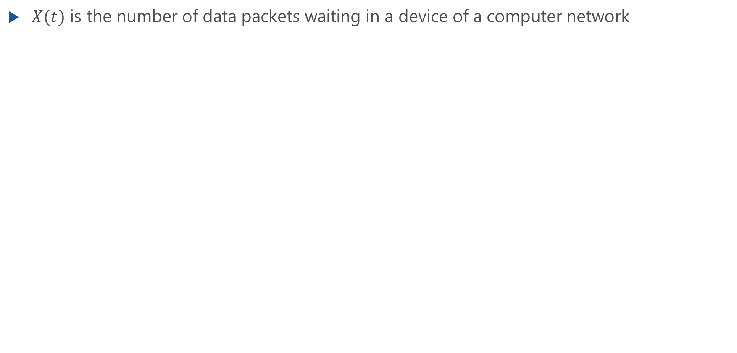
Example: IoT Gateway
Lecture
$X(t)$ is the number of data packets waiting in a device of a computer network

Slide 10
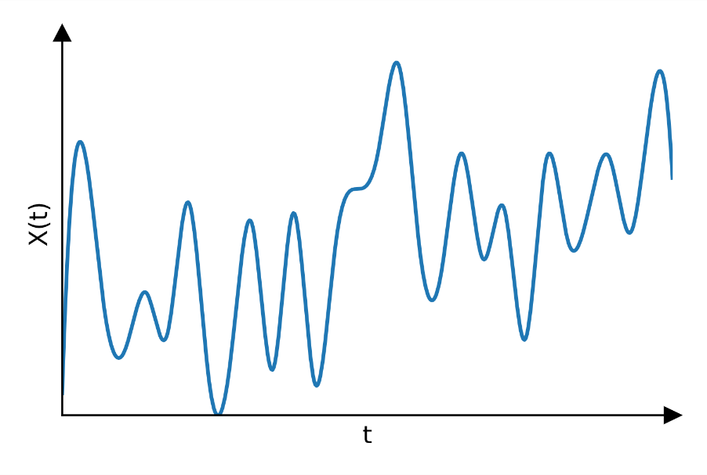
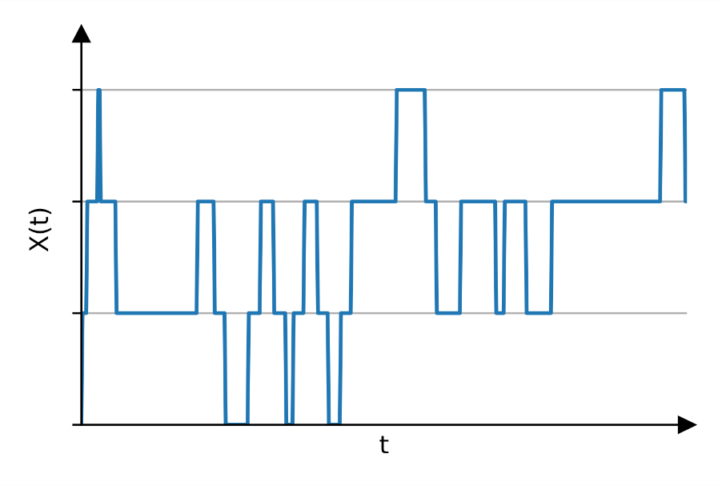
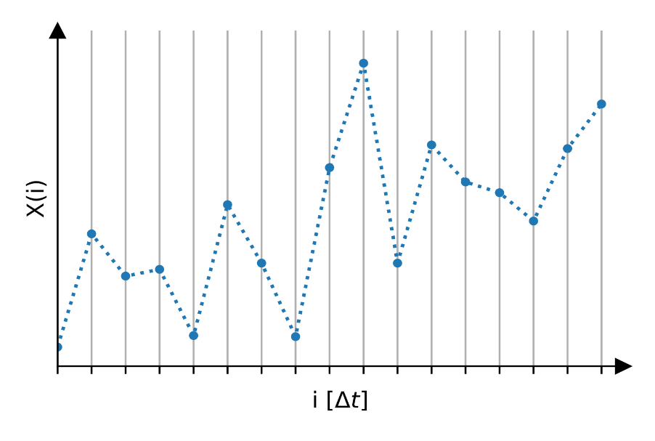
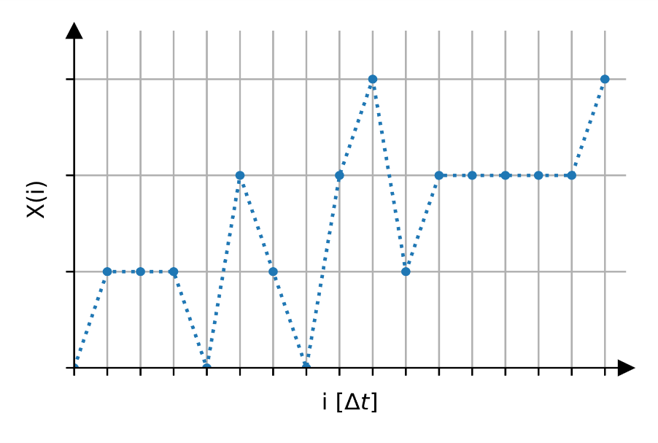
Classification of Stochastic State Processes
continuous state
discrete state
continuous
time
discrete
time

Slide 11
Markov Processes
Markov property

Slide 12
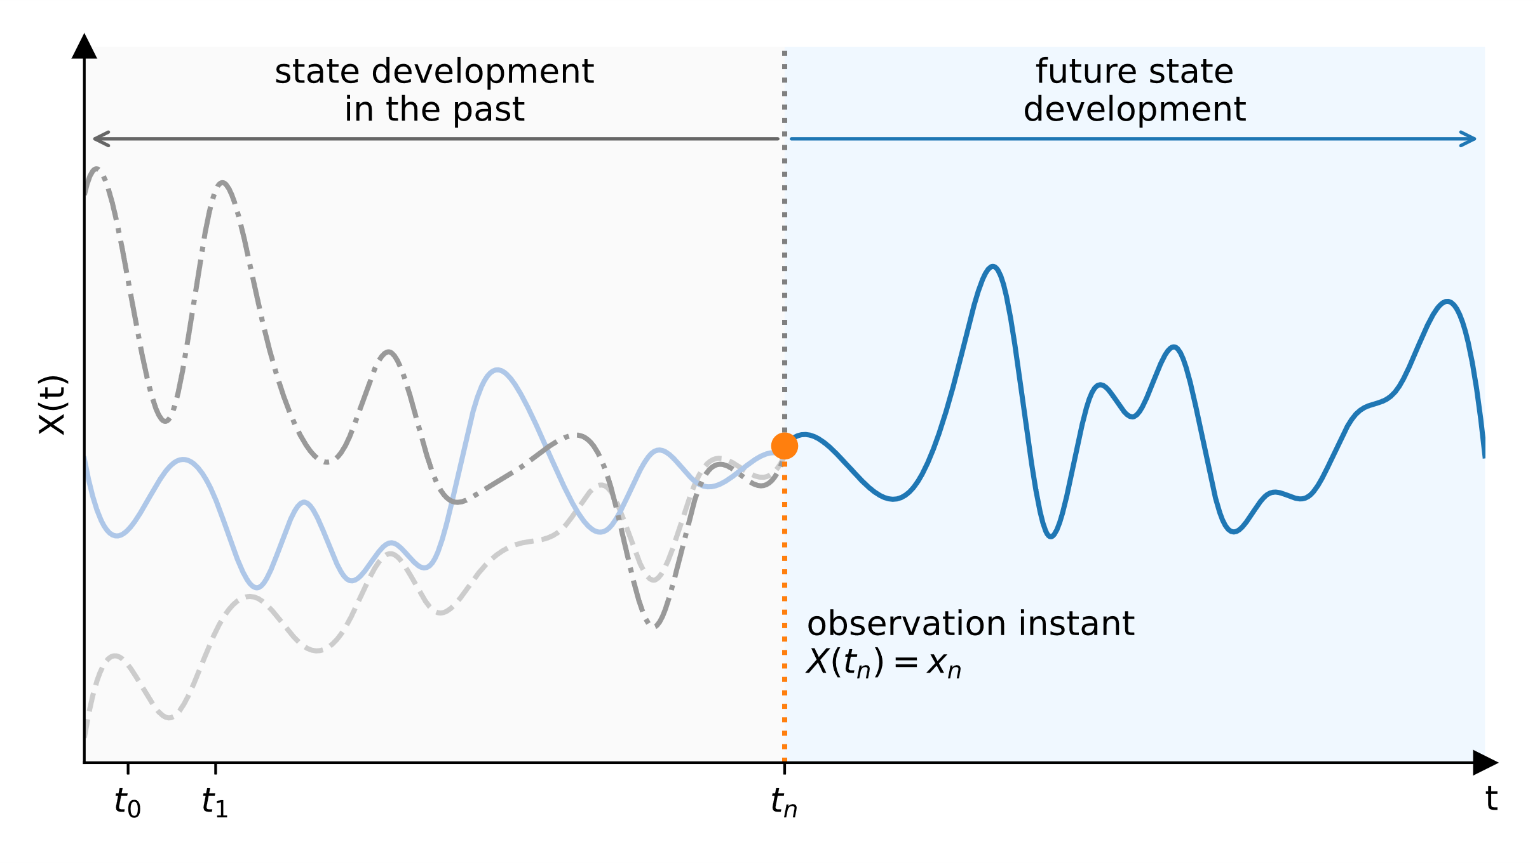
Markov Process
Future development can be calculated from current situation
Memoryless process
Definition of Markov Process

Slide 13
Memorylessness of a Random Variable
Lecture

Slide 14
Pareto Distribution
Lecture

Slide 15
Elementary Processes in Performance Models
Arrival process, service process, state process

Slide 16
Random Processes in Traffic Models
traffic source
arrival process
waiting room
service process
state process

Slide 17
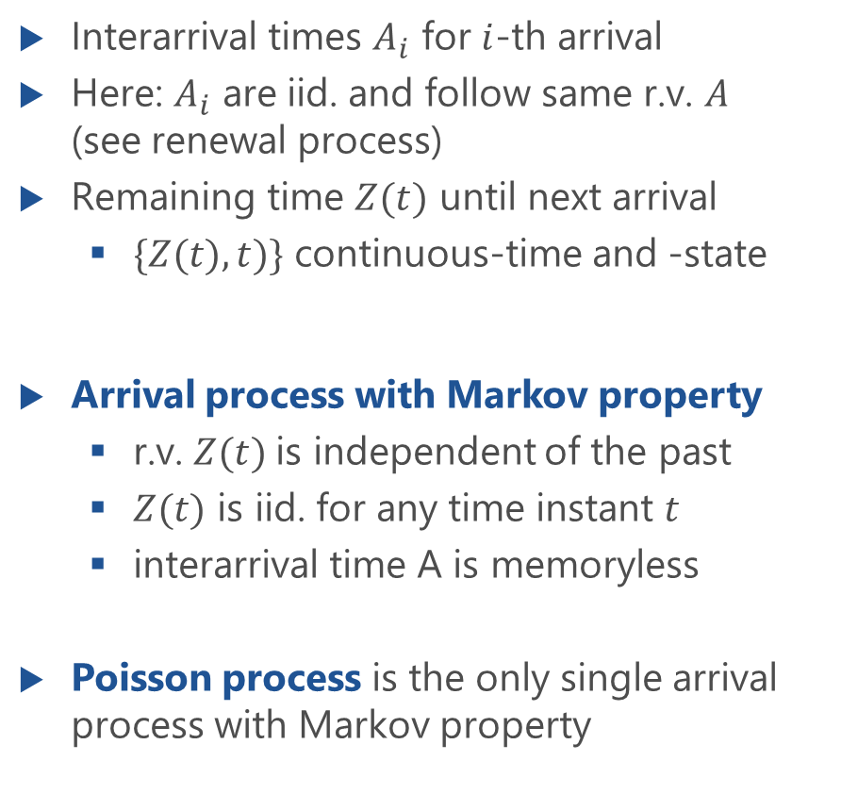
Characterization of Arrival Process
Interarrival times $A_{i}$ for $i$-th arrival
Here: $A_{i}$ are iid. and follow same r.v. $A$ (see renewal process)
Remaining time $Z(t)$ until next arrival
$\{Z(t),t)\}$ continuous-time and -state
Arrival process with Markov property
r.v. $Z(t)$is independent of the past
$Z(t)$ is iid. for any time instant $t$
interarrival time A is memoryless
Poisson process is the only single arrival process with Markov property

Slide 18
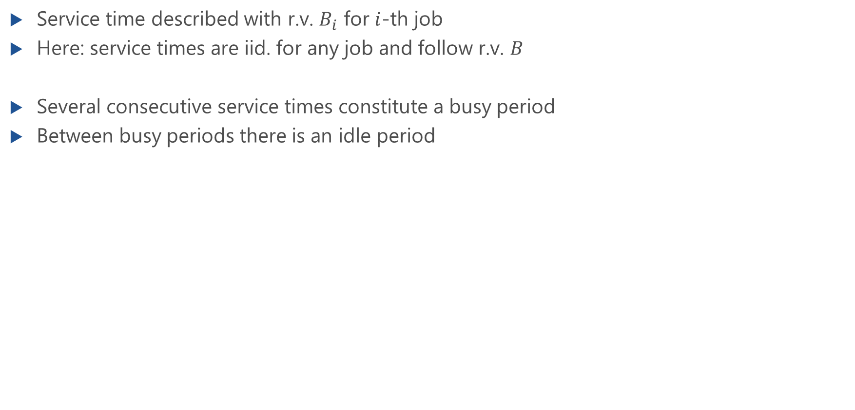
Characterization of Service Process
Service time described with r.v. $B_{i}$ for $i$-th job
Here: service times are iid. for any job and follow r.v. $B$
Several consecutive service times constitute a busy period
Between busy periods there is an idle period
Service process with Markov property
memoryless service time
duration until end of operation independent of the past
exponential distribution is the only continuous distribution with Markov property

Slide 19
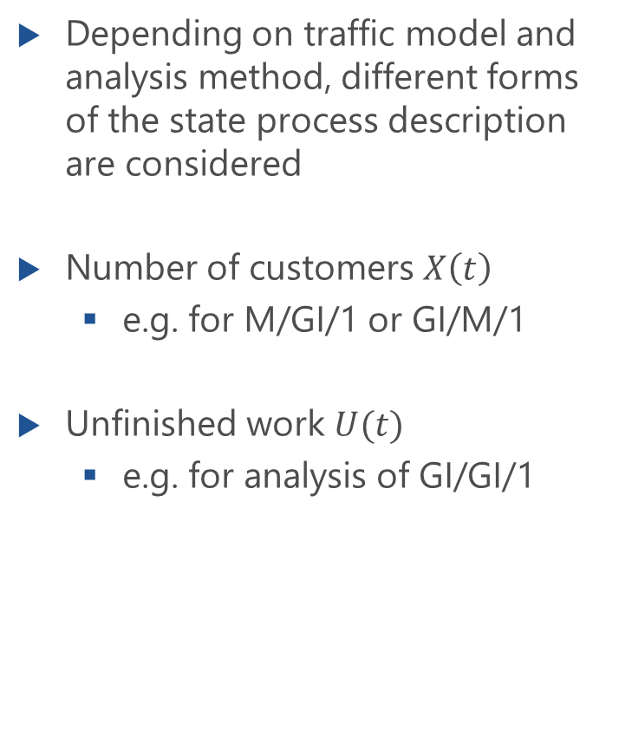
State Process
Depending on traffic model and analysis method, different forms of the state process description are considered
Number of customers $X\left(t\right)$
e.g. for M/GI/1 or GI/M/1
Unfinished work $U(t)$
e.g. for analysis of GI/GI/1

